Slide 1
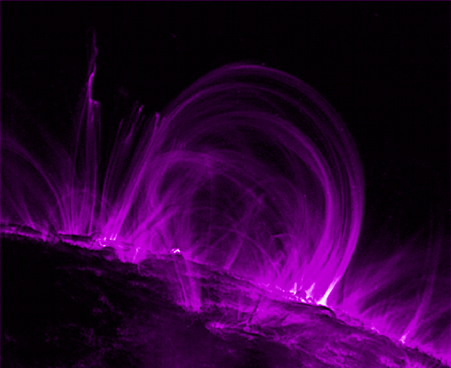
Magnetism and
Magnetic Fields

Slide 2
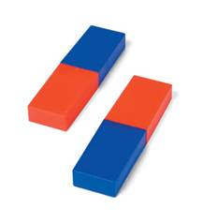
What Do Magnets Do?
Attract or repel other magnets (exert a force)
Attract other magnetic metals
Have at least 2 distinct ends (poles) each
Principle of Magnetism:
Like poles repel, opposite poles attract
Notes:
Do not need to touch to exert force
Can turn ferromagnetic metal objects into temporary magnets

Slide 3
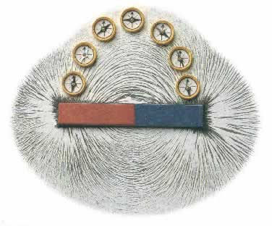
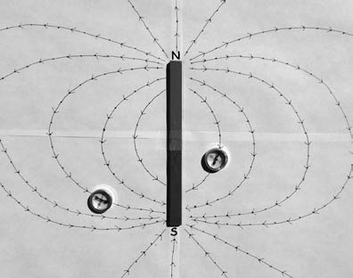
Magnetic Field-
is a force field like the gravitational field of the Earth
Magnetic field of a Bar Magnet:
Dipole field
Has a North and South Pole
Field lines point lines point from North to South

Slide 4
Magnetic Force Fields
When a N-pole and S-pole are brought close together, they begin to attract before they touch. (Action at a Distance ex. Gravity)
The effect of forces that act at a distance is described in terms of a “field of force”
We will call the space around a magnet in which magnetic forces are exerted as a magnetic field of force

Slide 5
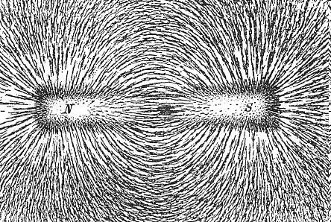
We cannot see magnetic fields, we can detect them using iron filings. The tiny pieces of iron line up in the magnetic field.
Bar Magnet

Slide 6
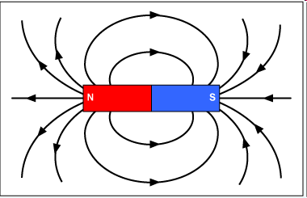
Rules
the field lines come out of N and go into S
the field lines are more concentrated at the
poles.
Lines
do not
cross
*** Magnetic field lines form closed loops

Slide 7
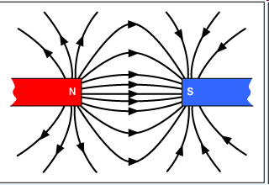
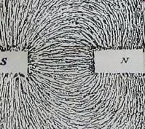
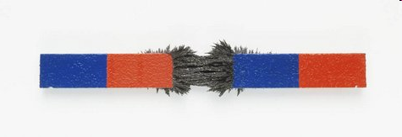
Attraction
Magnetic field lines between two attracting magnets

Slide 8
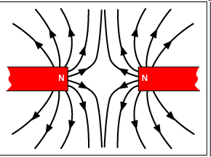
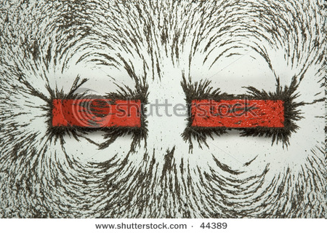
Repulsion
Magnetic field lines between two repelling magnets

Slide 9
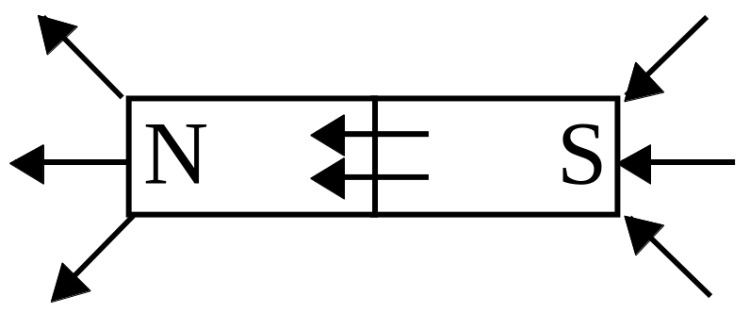
Magnetic Field Lines
The spacing of the lines indicate the relative strength of the force. The closer the lines, the greater the force.
Outside a magnet, the lines are concentrated at the poles.
Originate at North and terminate at South
Lines do not Cross
Form closed loops

Slide 10
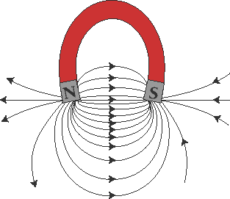
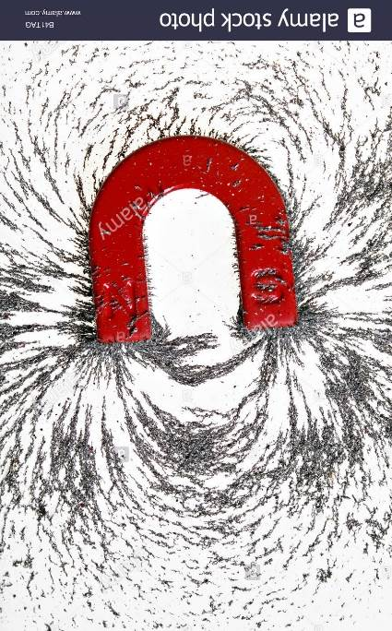
Horseshoe Magnet

Slide 11
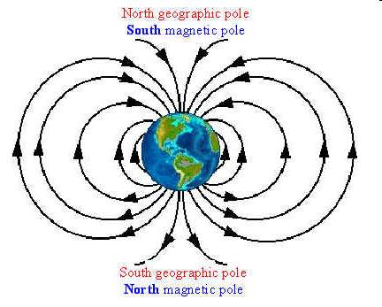
The Earth has a magnetic field as well..
The Earth has a magnetic field and north and south poles - operating as if it has a magnet in its center.

Slide 12
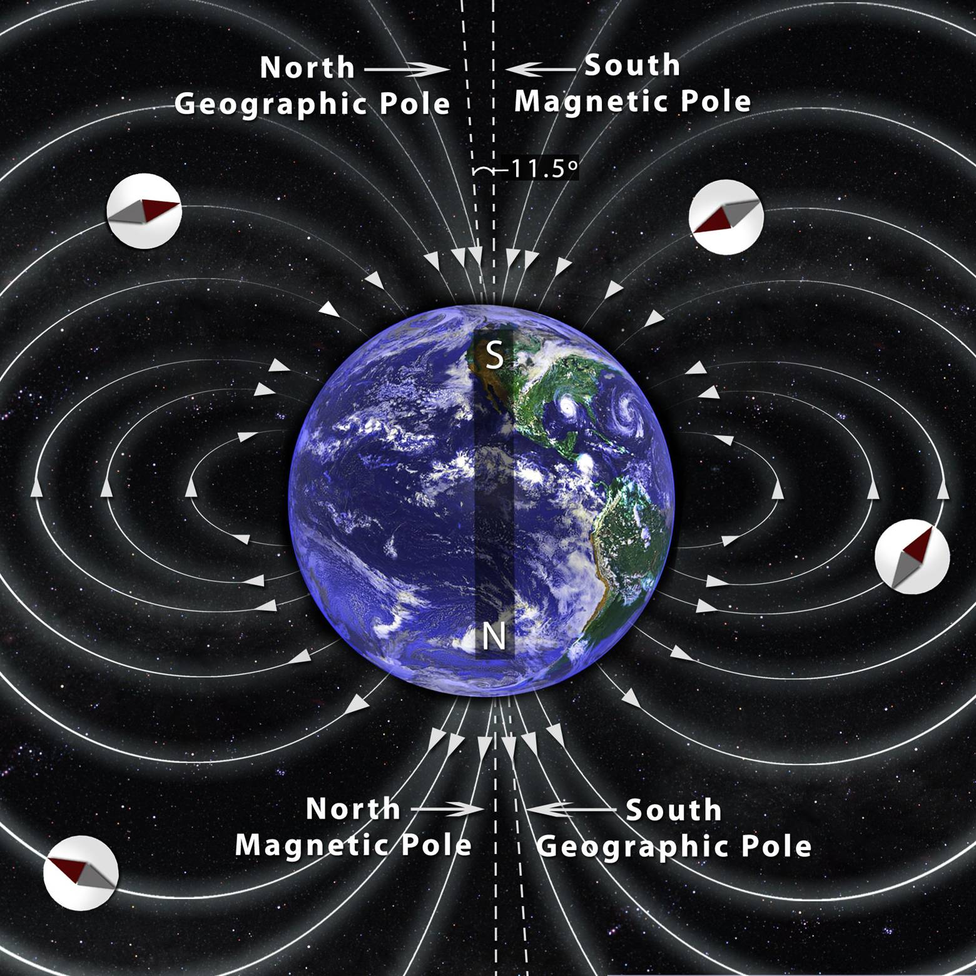
Earth: A Huge Bar Magnet
Moving molten iron in Earth’s outer core causes the Earth’s magnetic field.
Magnetic field poles are NOT aligned with geographic poles.
They also wander and flip (500,000 yrs between flips, 10,000 yrs to complete flip).

Slide 13
Magnetic Field Strength
A magnetic field produces a magnetic force on other magnets and electric charges!
  Magnets affect magnets
  Magnets affect electric current
  Electric current affects magnets
Symbol for magnetic field / Force is B
  B is a vector quantity
The unit for magnetic force is Teslas (T)
  Named after the famous Nikola Tesla
Magnetic Source | Strength (T)
Earth | 5x10⁻⁵
Bar Magnet | 1x10⁻²
MRI Medical Imaging | 15
Strongest man-made | 40
Neutron Star | 1x10¹¹

Slide 14


Slide 15
PRACTICE
PG. 552 # 5, 6

Slide 16
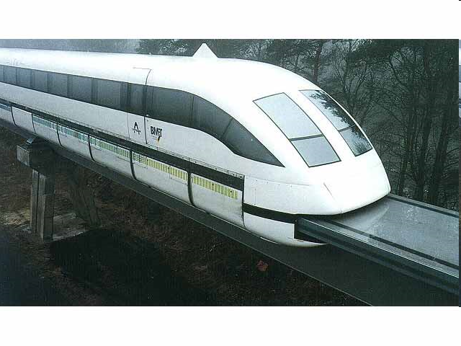
Fun Facts
Many scientists believe that birds are able to find their way home by using the Earth's magnetic field to guide them on long distance flights
Some veterinarians use magnets to pick up pieces of wire or other metal from inside the stomachs of large farm animals.
Today, new trains use magnets to lift them off the ground so that they float. Floating reduces friction and allows the train to run more efficiently.
Magnets can be
found in your
telephone, stereo,
vacuum cleaner,
refrigerator, washing
machine, car, TV,
VCR, and your
doorbell to name
a few.

Slide 17
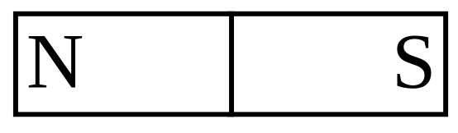
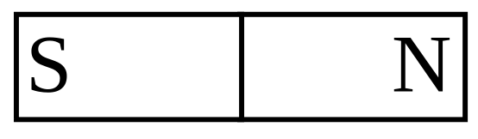
Sketch the magnetic field lines for the following situations:
a)
b)
DO: pg 584 # 3, pg 599 #1,8

Slide 18
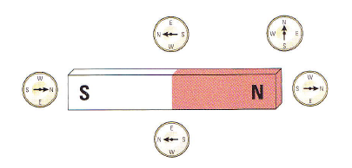
Lines of Magnetic Force
Magnets have “North” and “South” poles.
A compass is a small magnet
Activity:
  Use your collection of tiny compasses to map the lines of force around your magnet.

Slide 19
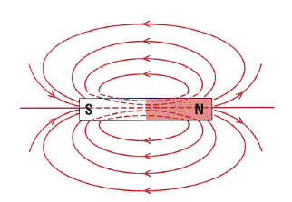
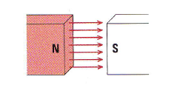
Magnetic Field Lines
We sometimes think of magnetism (and gravity) in terms of “force fields” surrounding the magnet (or mass).
Lines of magnetic force flow from North to South
The force is greater where the lines are closer together.

